Slide 1
Brain-based Treatment
For Binge Eating
Nicole Siegfried, PhD, CEDS
Chief Clinical Officer
Tammy Beasley, RDN, CEDRD, CSSD
Vice President of Clinical Nutrition Services
Notes:
TAMMY

Slide 2

The WAR Within
Notes:
Nicole
Read from Jekyl and Hyde: We regularly experience war with ourselves. This is not a new insight. For thousands of years philosophers, authors, artists and theologians have realized this. In more severe cases this shows up in compulsive and addictive behaviors. Is change possible? If so, how does it happen? There are no silver bullets but we keep learning things which are giving us hope.

Slide 3
Objectives
Illustrate how the brain is activated during urges to binge.
Understand the basic concepts of neuroplasticity to create new neural pathways in the brain.
Define and illustrate three keys points of reconnection to hunger and fullness
Describe practical methods for both dietitians and therapists to “unstick” the repetitive behaviors and facilitate brain rewiring.
Notes:
Nicole

Slide 4
The Mind and the Brain
Brain: the physical organ that responds to our environment through chemical and electrical impulses.
Mind: an embodied and relational process that regulates the flow of energy and information —Dan Siegel
Mind: the representation of your true self with the ability to focus attention and make choices according to your values
—Jeffrey Schwartz
Notes:
NICOLE

Slide 5
urges, restriction and the brain
What’s happening
in the brain?
Notes:
TAMMY

Slide 6
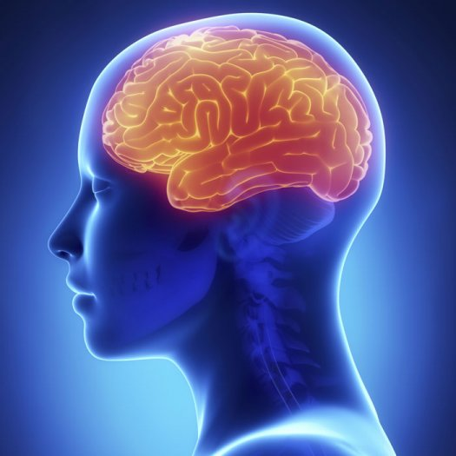
Non-Eating
Disorder Brain
INSULA
What should I do?
I look
fine
AMYGDALA
Eat it!
NUCLEUS ACCUMENS-
Yummy!
It’s OK
ORBITO- FRONTAL CORTEX
Ok
I’m hungry.
Tastes good!
CAUDATE NUCLEUS
PARIETAL LOBE
ANTERIOR CINGULATE CORTEX (ACC)
(Hill, 2013)
(Hill, 2017)
Notes:
NICOLE
When you’re eating and the signal comes up from the gut and moves through the thalamus and right into the insula. And the insula is the area of the brain that give an indication of hunger or fullness. The taste and the degree of hunger comes out of the insula.
Right next to the insula is the amygdala and that’s the alarm center of your brain. It says ok you’re hungry and it tastes good. All good…I’m going to stay calm.
Then it moves to the bottom of the striatum and this is the pleasure circuit. I made a decision to eat and it’s good, so you get a little dopamine spike. Whenever you make a decision you get pleasure from it – which is a little dopamine spike.
Then the front of the brain starts to interpret it- “this is good”
Then the Caudate begins to weigh decisions- what should I do here?

Slide 7
AN Brain
INSULA
DON’T
EAT!
I’m
HUGE!
AMYGDALA
What Should I do?!
NUCLEUS ACCUMBENS
Yuk!
EEEK!
ORBITO- FRONTAL CORTEX
Whoa!
I am not hungry …
And this tastes blah
CAUDATE NUCLEUS
PARIETAL LOBE
ACC
(Hill, 2013)
(Hill, 2017)
Notes:
NICOLE
IN the anorexic brain- I’m not hungry and this tastes blah

Slide 8
BN or BED Brain
INSULA
EAT! EAT!
I’m
HUGE!
AMYGDALA
What
should
I do?!
NUCLEUS ACCUMBENS
Yummy!
All Good!
GO!!
ORBITO- FRONTAL CORTEX
That Tastes Delicious!
CAUDATE NUCLEUS
PARIETAL LOBE
ACC
(Hill, 2013)
(Hill, 2017; Kessler et al., 2016; Matthes et al., 2009
Notes:
NICOLE

Slide 9
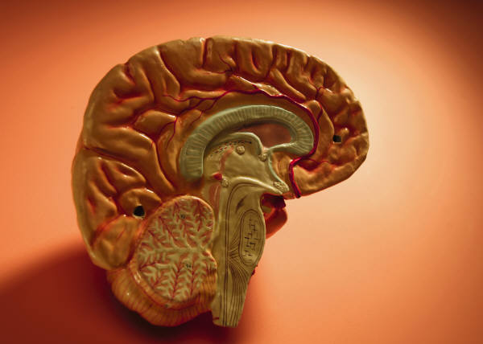
Brain Reward Circuitry:
Effects of Binge Eating
Dopamine hormone is released in response to “pleasure” signals (food)
Dopamine circuits are associated with reward
Brain will automate response to behavior if repeated often
“Want” it but do not have to “like” it
Bill Kelley, PhD. Center for Cognitive Neuroscience at Dartmouth College
Notes:
TAMMY
Dopamine is released in response to pleasure received from a binge; evidence supports that the brain begins automating its response to a behavior that is repeated, or rewarded, often.

Slide 10

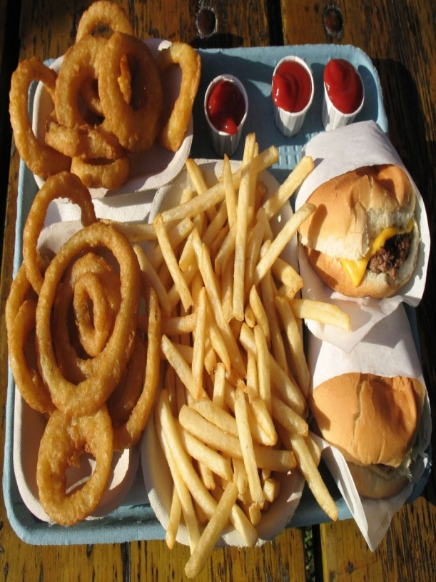
Prediction and Reward
If brain can predict reward, it will
respond to the dopamine trigger
This Photo by Unknown Author is licensed under CC BY-NC-ND
Notes:
TAMMY
So if the brain can predict a reward, it can respond to the dopamine trigger in the presence of, OR SIMPLY BY SEEING, the binge foods.

Slide 11
Brain Reward Circuitry:
Effects of Binge Eating
Evidence suggests that dopamine reward responses from “acute food pleasure” adjust over time; more required for same effect
Evidence suggests brain reward circuitry is more active with sugar-based foods in hungry subjects vs. satiated subjects
Schag et al., 2013; Kessler et al., 2016; Davis, 2015
Notes:
TAMMY
Evidence also suggests that the brain reward circuitry is more active when sugary foods are consumed in hungry subjects as compared to subjects who are satisfied, and not hungry.

Slide 12
The Binge Teaches the Brain That…
The automated response to binge foods is physiologically “learned” and not simply “failed willpower”
Periods of restriction as “punishment” for a binge can lower blood sugar levels and subsequently increase the desire for sugary-based binge foods in a hungry state.
Schag et al., 2013; Kessler et al., 2016; Davis, 2015
Notes:
TAMMY
Evidence also suggests that the brain reward circuitry is more active when sugary foods are consumed in hungry subjects as compared to subjects who are satisfied, and not hungry.

Slide 13
Cortisol Feeds the Problem
Stress triggers cortisol release
Cortisol looks for stored glucose to “feed” stress
Increases release of glucose from liver to blood
Decreases storage of glucose from blood to liver
Triggers release of more insulin which can cravings
Notes:
TAMMY

Slide 14
Consequences of the binge/dieting cycle
Binge eating episodes increase exponentially with the frequency of dieting or restriction.
More cortisol is produced by the stress response from dieting itself.
Holmes et al. 2014; Tomiyama et al. 2010.
Notes:
TAMMY
Evidence also suggests that the brain reward circuitry is more active when sugary foods are consumed in hungry subjects as compared to subjects who are satisfied, and not hungry.
Yet it is easier for our clients to see their cravings as lack of willpower, vs a physiological response from both dopamine triggers and blood sugar imbalance…which in turn increases stress, and on and on….

Slide 15


The single most pervasive intersection between the distorted thoughts and the binge itself is SHAME.
Notes:
TAMMY

Slide 16

The brain cannot rewire when it is emotionally flooded
This Photo by Unknown Author is licensed under CC BY-SA
Notes:
TAMMY
The brain has less capability of creating new pathways to handle familiar urges when it is being flooded under a swell of emotions. When the brain is flooded under a wave of shame and hopelessness, it is very difficult to interrupt, slow down or even see another way out of the familiar binge cycle.

Slide 17

Neutralizing messages around food choices and body changes increase the brain’s “response flexibility”
This Photo by Unknown Author is licensed under CC BY-SA
Notes:
TAMMY
Consider the impact that flood gates can have on protecting the land and community. These flood gates, built over time as a counter response to repeated flood patterns, hold back the rush of water and open opportunities for the community to take different routes to safety. Likewise, if the cycle of emotional flooding is slowed down by a flood gate, the brain can then begin to emotionally engage in a new way within a safe space. A fresh pathway begins to develop.
This is called Response Flexibility - the capacity to demonstrate restraint, to allow enough time between what we sense emotionally and how we choose to act. During this time, we can actually think and reflect, and see another way out.

Slide 18

Our most important objective:
Guide our clients to see a new way out of the binge/ restrict cycle through:
A filter for shame reduction
A lens of self-compassion
A frame of hope
Notes:
TAMMY

Slide 19
urges, restriction and the brain
How can new neural pathways in the brain be created?
Notes:
NICOLE

Slide 20
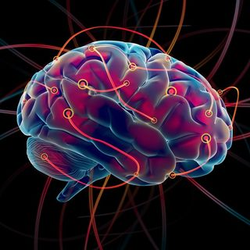
Rewiring the Brain
Neurogenesis
  Birth of new neurons
Neuroplasticity
  Malleability of neural circuits
Neural Darwinism
  Neural pruning
Hebb’s Law
  Fire together=wire together
Quantum Zeno Effect
  Attention density
(Schwartz, 2016)
Notes:
Nicole
Gray matter can actually shrink or thicken; neural connections can be forged and refined or weakened and severed. Changes in the physical brain manifest as changes in our abilities. For example, each time we learn a new dance step, it reflects a change in our physical brains: new "wires" (neural pathways) that give instructions to our bodies on how to perform the step. Each time we forget someone's name, it also reflects brain change— "wires"that once connected to the memory have been degraded, or even severed. As these examples show, changes in the brain can result in improved skills (a new dance step) or a weakening of skills (a forgotten name).
The ability of the brain to change structure and function based on input from repeated behaviors, emotions, and thoughts is an empowering truth of the last decade with far reaching implications and possibilities for almost every aspect of human life and culture. However, this same characteristic, making your brain amazingly resilient, also makes it very vulnerable to outside and internal, usually unconscious, influences. In his book The Brain That Changes Itself: Stories of Personal Triumph from the Frontiers of Brain Science, Norman Doidge calls this the “plastic paradox.”

Slide 21
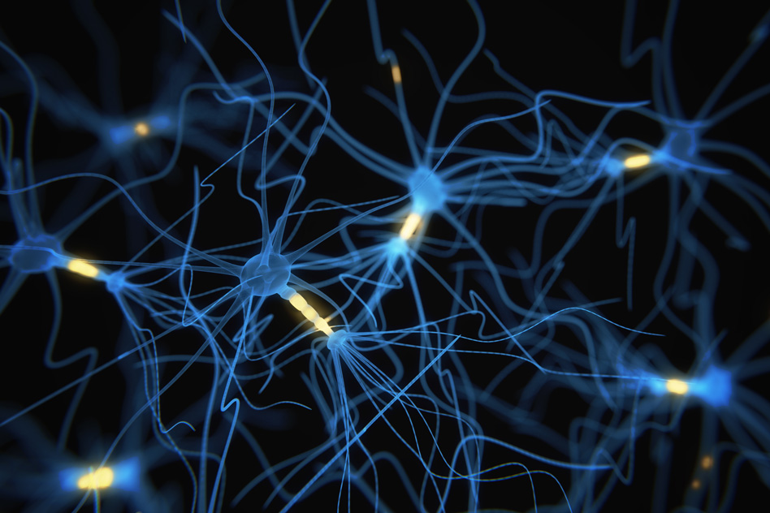
Notes:
nicole

Slide 22

Notes:
Nicole

Slide 23
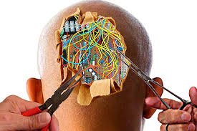
Rewiring the Brain
Self-Directed Neuroplasticity
  Rewiring or retraining your brain away from automatic behaviors to new behaviors
(Schwartz, 2016)
Notes:
Nicole

Slide 24

Notes:
Nicole

Slide 25
Rewiring the Brain by
Rediscovering Hunger and Fullness
Fuel Balance
Repetition
MEAL TIMING
Notes:
Tammy
Rediscovering hunger and fullness is developing a new brain pathway…and three equally important steps help deepen this new pathway over time

Slide 26
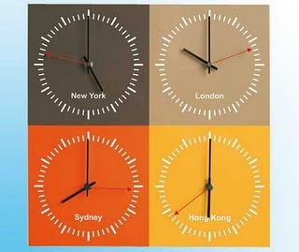
Research on Meal Timing
Adjusted mealtimes reset body clock
Brain is the “clock” for sleep/ body temperature
Liver is “clock” for food metabolism
Study: After 2 days of adjusted mealtimes, liver’s rhythm shifted 10 hours.
Wehrens, SMT, et al. Current Biology. 2017.
Notes:
Tammy
The jet lag experience is an example of how meal timing itself can readjust our hunger/fullness cycle. We don’t feel guilty about eating when we aren’t hungry when we are adjusting to a new time zone – the emotional flooding is held back and a new pathway is allowed to develop

Slide 27

Research on Meal Timing
“Meal timing exerts a variable influence over human physiological rhythms, with notable changes occurring in aspects of glucose homeostasis.”
Translation?
A 5-hour delay between meals changed glucose balance but did NOT influence insulin balance the same way
Reduced glucose without subsequent reduction in insulin creates insulin-produced hypoglycemia – increasing sugar cravings
Bottom line: Meal timing matters
Wehrens et al. 2017
Notes:
Tammy

Slide 28

Flood Gate Analogy
Flood Gate:
Consistent meal/snack times
Restores and normalizes body’s “appetite-based” eating pattern
Resets body’s metabolic clock
Reduces insulin-produced hypoglycemia
Serve as a flood gate to allow new pathways to develop
This Photo by Unknown Author is licensed under CC BY-NC-ND
Notes:
Tammy

Slide 29
Rediscovering
Hunger and Fullness
FUEL BALANCE
Repetition
Meal Timing
Notes:
Tammy

Slide 30
What IS Balance?
Balance is defined as “to bring to equilibrium“, “equal in value”, including emotional stability.
Balance is not only in the tangible food choices but also the intangible emotions and judgment around food
Notes:
Tammy
Recognizing physical balance in fuel choices themselves and emotional balance supporting those choices as equally important.

Slide 31
Research on Balance & Variety
Better outcomes w/ increase in energy dense foods
  Fats
  Complex carbohydrates
  Proteins* Schebendach et al., JADA 2011
Decreased desire to binge or overeat after consuming meals adequate in protein Herrin M, Larkin M. 2013
Longer thermic effects after eating meals with adequate protein compared to similar amounts of carbs or fats
    Li, Jia, et al. Nutrients 2016.
Notes:
Tammy
Why variety?

Slide 32

Balance/Variety Requires Permission…
How do different fuel combinations …
  Feel in your body?
  Sustain your energy?
  Change your mood?
Notes:
TAMMY
Notice the word “fuel” in place of “food” – it is a conscious choice that also serves as a flood gate to hold back the emotional meanings attached to food created by disordered eating thoughts and beliefs. Fuel implies a more neutral description and active purpose that can help diffuse anxiety and fear that may be triggered by the word “food” itself.
The fuel choices made for each meal and snack are uniquely varied for each person and offer opportunities to experiment with how different combinations of fuel choices feel both physically and emotionally. The flood gate of fuel balance offers unlimited opportunities to hold back the emotional flooding with neutral language and with each different combination and try out the new pathways that are beginning to develop.

Slide 33

Permission Requires Curiosity…
This Photo by Unknown Author is licensed under CC BY-NC-ND
Notes:
TAMMY

Slide 34
Flood Gate Analogy
Flood Gate:
Balance of fuel groups
Variety reduces cravings
Choosing balance and variety requires permission
Permission opens door to curiosity
Curiosity reduces shame and embraces both physical and emotional responses
This Photo by Unknown Author is licensed under CC BY-NC-ND
Notes:
Tammy

Slide 35
Rediscovering Hunger and Fullness
Fuel Balance
REPETITION
Meal Timing
Notes:
Tammy
Repetition: simply holding back the emotional flooding through meal timing and fuel balance blended with shame reduction…and repeating this process……
May differ in how long between and what types of fuel, but the repetition itself is what reinforces the new pathway

Slide 36

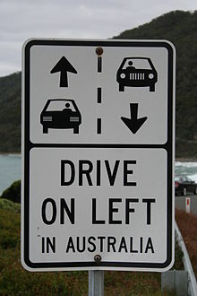
Hunger and Fullness Analogies
A New Way to Drive
This Photo by Unknown Author is licensed under CC BY-SA
Notes:
Tammy

Slide 37
Flood Gate Analogy
Flood Gate:
Repetition and permission
Restores confidence that change is possible
Rewires by building a new pattern from repetition itself
This Photo by Unknown Author is licensed under CC BY-NC-ND
Notes:
Tammy

Slide 38
Rewiring the Brain
Step 1: RELABEL: The art of being aware
  Identify your thoughts and urges as uncomfortable sensations (Call it like it is!)
    Instead of “I am huge”! Or “I must eat”! Or “I am sad!”...
      I am having the thought…
      I am having the urge…
      I am having the feeling…
(Schwartz, 2016)
Notes:
nicole
BIO BEHAVIORAL INTERVENTIONS
THIS IS MINDFULNESS!

Slide 39

Rewiring the Brain
Step 1: RELABEL (cont’d)
  This is mindfulness!
    “Impartial spectator”
    “Curious detective”
(Schwartz, 2016)
Notes:
Nicole

Slide 40
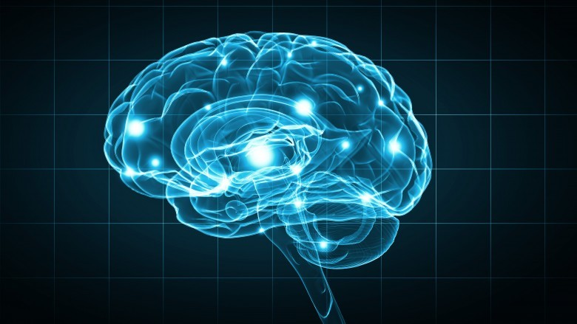
Rewiring the Brain
Step 2: REATTRIBUTE: The different perspective
  “This is my brain mis-firing”
  “This is my brain trying to follow its well-worn path”
(Schwartz, 2016)
Notes:
nicole

Slide 41
Rewiring the Brain
Step 3: REFOCUS: The power of attention
  Shift the gears yourself
  “I am experiencing an automatic urge related to my eating disorder. I need to do another behavior.”
  Opposite action
  15 minute rule
(Linehan, 1993; Schwartz, 2016)
Notes:
nicole
The Refocus step is where the real work is done. In the beginning, you may think of it as the "no pain, no gain" step. Mental exercise is like a physical workout. In Refocusing, you have work to do: You must shift the gears yourself. With effort and focused mindfulness, you are going to do what the caudate nucleus normally does easily and automatically, which is to let you know when to switch to another behavior. Think of a surgeon scrubbing his hands before surgery: The surgeon doesn't need to wait for a timer to go off to know when it's time to stop scrubbing. After a while, the behavior is simply automatic. After a while he gets a "feel" for when he's scrubbed enough. But people with OCD can't get the feeling that something is done once it's done. The automatic pilot is broken. Fortunately, doing the Four Steps can usually fix it.
In Refocusing, the idea is to work around the OCD thoughts and urges by shifting attention to something else, if only for a few minutes. Early on, you may choose some specific behavior to replace compulsive washing or checking. Any constructive, pleasant behavior will do. Hobbies are particularly good. For example, you may decide to take a walk, exercise, listen to music, read, play a computer game, knit, or shoot a basketball.
When the thought comes, you first Relabel it as an obsessive thought or a compulsive urge and then Reattribute it to the fact that you have OCD--a medical problem. Then Refocus your attention to this other behavior that you have chosen. Start the process of Refocusing by refusing to take the obsessive-compulsive symptoms at face value. Say to yourself, "I'm experiencing a symptom of OCD. I need to do another behavior."
You must train yourself in a new method of responding to the thoughts and urges, redirecting your attention to something other than the OCD symptoms. The goal of treatment is to stop responding to the OCD symptoms while acknowledging that, for the short term, these uncomfortable feelings will continue to bother you. You begin to "work around" them by doing another behavior. You learn that even though the OCD feeling is there, it doesn't have to control what you do. You make the decision about what you're going to do, rather than respond to OCD thoughts and urges as a robot would. By Refocusing, you reclaim your decision-making power. Those biochemical glitches in your brain are no longer running the show.

Slide 42
Rewiring the Brain
Step 4: REVALUE: The power of future
  Wise advocate
  Creating a life worth living
  “the thought of being fat is coming and going and I’m going to have a life anyway… people live their lives in spite of their chronic pain, loss and other distressing experiences and I am right now going to live despite my thoughts.. they are not me.. and I am learning to tune them out and it takes time.”
(Schwartz, 2016)
Notes:
nicole

Slide 43
Rewiring the Brain
Step 4: REVALUE: The power of future
  Access gratitude
    “Count your Blessings” exercise
    Gratitude letters/gratitude phone calls
Notes:
nicole

Slide 44
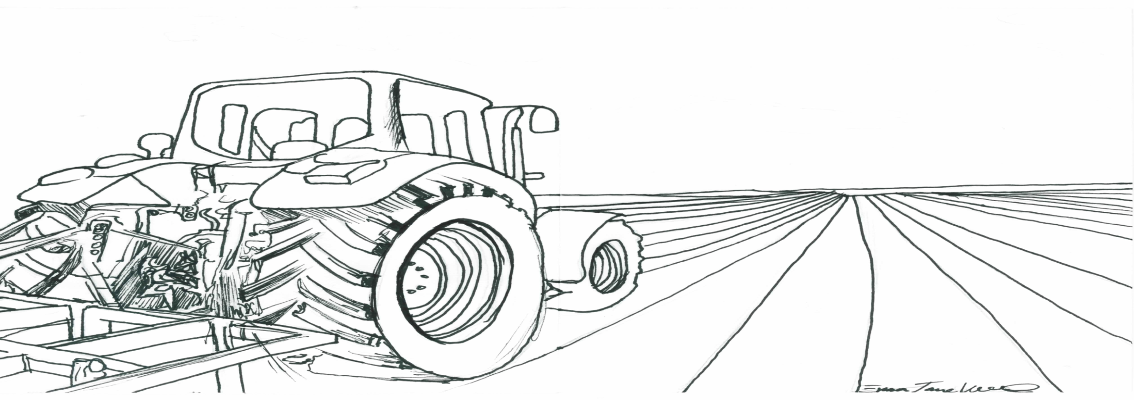
Rewiring the Brain
Step 4: REVALUE: The power of future
Identify core values and values in action
-- Values questionnaire
-- Creating your “life garden”
(Wilson, 2014)
Career
Education
Family
Spirituality
Notes:
nicole

Slide 45
Conclusion
Questions?
Notes:
both

Slide 46
References
References
Cell Press. "Delayed meal times reset body clocks." ScienceDaily. ScienceDaily, 1 June 2017. www.sciencedaily.com/releases/2017/06/170601124004.htm>.
Davis C. The epidemiology and genetics of binge eating disorder. CNS Spectr. 2015; 20: 522-529.
Donnelly, B.,Touyz, S., et al. (2018). Neuroimaging in bulimia nervosa and binge eating disorder: a systematic review. Journal of Eating Disorders, 6, 3. http://doi.org/10.1186/s40337-018-0187-1
Herrin, M, Larkin M. Nutrition Counseling in the Treatment of Eating Disorders. Taylor & Francis, New York; 2013.
Hill, L. (2018). A brain-based approach to eating disorder treatment. Retrieved from https://brainbasedeatingdisorders.org/etext
Holmes, M. et al. Improving Prediction of Binge Episodes by Modelling Chronicity of Dietary Restriction. European Eating Disorders Review: 12 August 2014; https://doi.org/10.1002/erv.2315
Kelley B. (Center for Cognitive Neuroscience at Dartmouth College). “How the brain forms new habits: why willpower is not enough.” Institute of Natural Resources Workshop, Huntsville, AL. February 2013.
Notes:
both

Slide 47
References
References
Kessler, R., Hutson, P., Herman, B., & Potenza, M. (2016). The neurobiological basis of binge eating disorder. Neuroscience Biobehavioral Review, 63, 223-238.
Lask, B., & Frampton, I. (2011). Eating disorders and the brain. New York: Wiley.
Li, J, Armstrong, CLH, Campbell, WW. Effects of Dietary Protein Source and Quantity during Weight Loss on Appetite, Energy Expenditure, and Cardio-Metabolic Responses. Nutrients 2016, 8(2), 63; doi:10.3390/nu8020063
Linehan, M. M. (1993). Diagnosis and treatment of mental disorders. Cognitive-behavioral treatment of borderline personality disorder. New York, NY, US: Guilford Press.
Marek RJ, Ben-Porath DD, Federici A, et al. Targeting premeal anxiety in eating disordered clients and normal controls: a preliminary investigation into the use of mindful eating vs. distraction during food exposure. Int J Eat Disord. 2013 Sep;46(6):582-5. doi: 10.1002/eat.22152. Epub 2013 Jun 5.
Mathes, W., Brownley, K., Mo, X., & Bulik, C. (2009) The Biology of Binge Eating. Appetite, 52(3), 545–553.
Notes:
both

Slide 48
References
References
Reiff DW, Reiff KKL. Eating Disorders: Nutrition Therapy in the Recovery Process, Aspen Publishers; 1997.
Schag K, et al. Food-related impulsivity in obesity and binge eating disorder- A systematic review. Obes Rev 2013;14: 477-495
Schebendach, JE, Mayer, LE, Devlin, MJ, et al. Food choice and diet variety in weight-restored patients with anorexia nervosa. J Am Diet Assoc. 2011 May; 111(5): 732-736.
Schwartz, J. (2016). Brain lock: Free yourself from obsessive-compulsive behavior. New York: Harpers Collins.
Sherman, H, Genzer Y, Cohen R, et al. Timed high-fat diet resets circadian metabolism and prevents obesity. FASEB J. 2012 Aug;26(8):3493-502. doi: 10.1096/fj.12-208868. Epub 2012 May 16.
Sophie M.T. Wehrens, S.C., Isherwood, C, et al. Meal Timing Regulates the Human Circadian System. Current Biology, 2017; DOI: 10.1016/j.cub.2017.04.059
Notes:
both

Slide 49
References
References
Tchanturia, K. (2014). Cognitive remediation therapy for eating and weight disorders. London: Routledge.
Tomiyama, A. et al. “Low Calorie Dieting Increases Cortisol.” Psychosomatic Medicine 72 (4):357-64.
Wilson, K. (2010). Things may go terribly horribly wrong. New York: New Harbinger.
Notes:
both

