Slide 1


Family Therapy: Support vs. Colluding
Locations:
St. Louis, MO//Pacific Grove, CA//Birmingham, AL
Christine Schneider, LCSW, Lead Therapist, Director of Family Programming
1

Slide 2
Family Therapy: Support vs. Colluding
How do you work with families to provide support around recovery rather than colluding with the eating disorder?
Supporting: Emotional, physical, or financial assistance that aids in the process of recovery
Colluding: Emotional, physical, or financial assistance that aids in promotion of the eating disorder

Slide 3
Outline for Presentation
Assessment of Family System
Contingent Communication
Blocks to Contingent Communication
Tools for Use with Families/Clients

Slide 4
How Do You Assess?
Client’s Perspective:
  Who do you go to for support in the family?
    Include siblings, aunts, uncles, children
  What is the relationship like in times of recovery?
  What is the relationship like in times when the eating disorder is active?
    How are things different in times of recovery vs. ED? Does the eating disorder pull people in differently?

Slide 5
How Do You Assess
Parent’s Perspective:
  What is your relationship like with the client?
    In times of recovery?
    When the eating disorder is active?
    Does the eating disorder bring family members in softer? Are they more present and available? Or does it create distance/boundaries?

Slide 6
How Do You Assess?
Parental/Familial Enmeshment:
  Feeling a sense of responsibility for recovery
    Ie. being the “food police”: monitoring food, force feeding through guilt or shame; intrusive assistance around bathroom monitoring, locking cabinets, etc.
    Worrying about “triggering a relapse” if not always available, saying the right thing
    “Walking on Eggshells”
    May block attempts for independence/autonomy

Slide 7
How Do You Assess?
Parental/Familial Distance:
  Family members may feel angry, abused, manipulated
  May set boundaries such as “Don’t call me until you are in recovery” in an attempt to increase motivation
  Client may triangulate one enmeshed parent with distant parent, ie. using guilt around dad’s absence to manipulate mom

Slide 8
Contingent Communication
Contingent Communication:
  Family member perceives signal
  Family member correctly processes the signal
  Family member responds appropriately (Siegel, 2003)
Response Flexibility: the result of the brain’s ability to take in information, attach meaning to incoming cues and internal responses that these cues provoke, and apply logical thought to possible responses based on previous lessons (Van der Kolk, 2006)

Slide 9
What is Required for Contingent Communication?
Appropriate, flexible boundaries
Remaining in the Window of Tolerance
Dealing with ED/Self Hate Talk
Going Deeper
Avoiding “Parental PTSD”

Slide 10
Appropriate, Flexible Boundaries
Are family members in agreement about appropriate boundaries?
  Financial support, living arrangements, school tuition, etc.
  “Rescuing” from treatment
  Communication/collaboration with treatment team
  Do they communicate a “joint narrative”?
  Are the boundaries consistent and liveable?

Slide 11
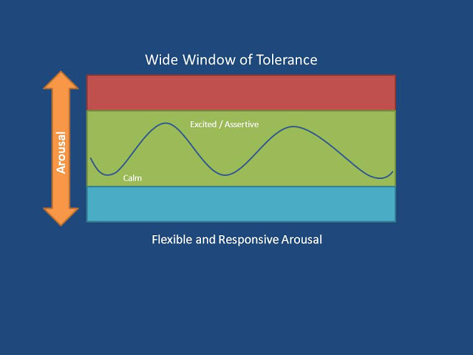
Window of Tolerance/Activation

Slide 12
Dealing with ED/Self-Hate Talk
Responding to clients who lead with self-hate or eating disorder talk
  “You can’t make me eat this food, I’ll get fat!” or
  “Why don’t you see how useless, worthless, ugly, etc. I am?”
  *Every time you get into a power struggle with ED or self-hate, YOU WILL LOSE

Slide 13
Going Deeper
View the eating disorder behaviors or self-hate as an indirect way of communicating a need or fear… get curious about the underlying struggle…
  Ie. “You can’t make me eat the food… I’ll get fat”.
    Response… “What emotions are coming up? What else could this be about?”
  Ie. “Why don’t you see how useless, worthless, ugly, etc. I am?”
    Response… “I don’t believe that about you, but I also want to hear about what is going on that would make you say that”

Slide 14
Avoiding “Parental PTSD”
Previous events around the ED or comorbid behaviors may have been so scary, shocking, or unpredictable that parents or family members may have a PTSD-type response to any struggle. This may include hypervigilance, hopelessness or helplessness, intrusive memories, etc.
  UNFORTUNATELY since recovery is not a linear process, this response can block a client from seeking support due to parent’s intense fear and overreaction

Slide 15
Tools for Parents
How do you stay within the Window of Tolerance?
  Self-soothing skills, time out strategies
  Remain curious rather than defensive or responding from fear
  Remain emotionally present and attuned
  Reflective Dialoguing
Signs you are either flooded or disconnected:
  Wanting to “fix it” instead of support your loved one
  Getting angry, anxious, reactive to the eating disorder (ie. becoming the “food police”)
  Dismissing or avoiding symptoms
  Reacting in a completely logical manner devoid of emotion

Slide 16
Relational Red/Yellow Green
Red/Yellow/Green is a relapse prevention tool wherein the client writes what the eating disorder looks like at each stage.
Red: Eating disorder is out of control, outside help is required
    Client may ask for treatment team to be called at this point.
Yellow: Struggle is evident, but it is a “productive struggle”
    Client may need contingent communication; reflective dialoguing, maybe some help with accountability or support around food
Green: No current struggle
    Client may ask for conversation focused outside of the ED
  A tool to help families and clients collaborate on what the support would look like at each level
  A way of allowing families to avoid over/under responding

Slide 17
Resources for Parents
Parenting from the Inside Out, Dan Siegel
Daring Greatly, Brene Brown
The Whole Brained Child, Dan Siegel

